Slide 1


DAE-Aware Bayesian Inference for Joint Generator-Network Parameter Estimation
Abdallah Alalem Albustami, Ahmad F. Taha, and Sankaran Mahadevan

Slide 2
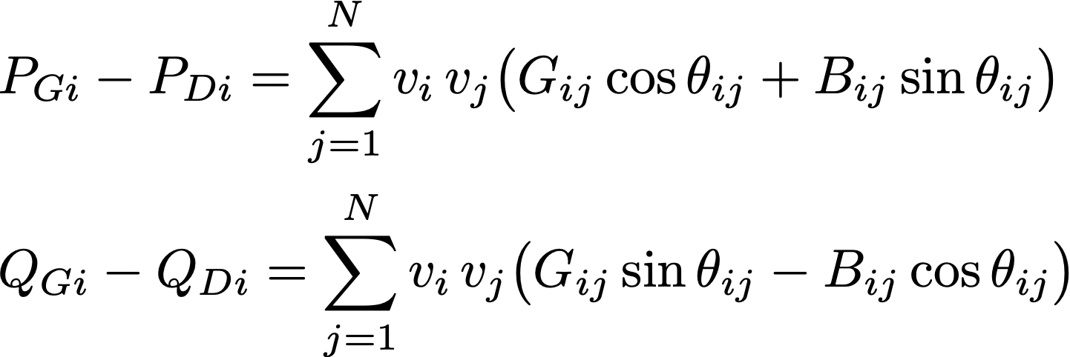
Motivation
Parameters change (rewinding, aging, temp.), need accurate estimates
Estimating generator parameters (inertia, damping)
Estimating network parameters (susceptance, conductance)
Decoupled
Inertia
Damping
Conductance
Susceptance
Notes:
Algebraic constraints (power flow equations or the current admittance form)

Slide 3
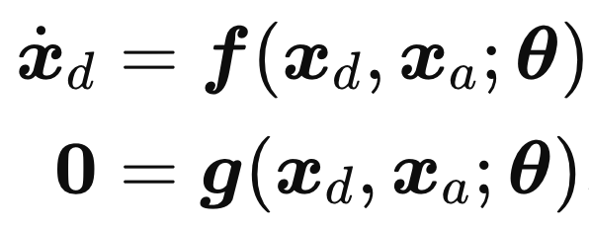
Motivation
Coupled
Inertia
Damping
Conductance
Susceptance
Generator dynamics (2nd to 8th order)
Algebraic constraints
Nonlinear Differential Algebraic Equations Model (DAE)
Notes:
Algebraic constraints (power flow equations or the current admittance form)

Slide 4
Not another estimator
Does uncertainty in network or generator parameters bias the estimation of the other parameter group?

Slide 5

Literature
EKF, UKF, CKF
LS, TLS, WLS
DREM
Observers
Optimization
ML methods
Point estimates, decouple the estimation problem
Bayesian Inference
Want an uncertainty-aware approach for the coupled generator-network DAE inverse problem

Slide 6
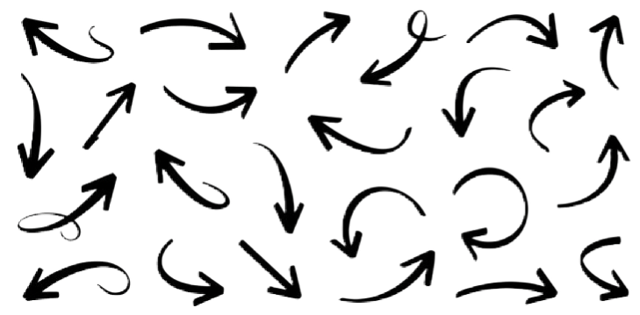
Problem
Given
Obtain
Measurements (PMU data)
Parameter estimates
Prior knowledge of parameters
Quantify uncertainty
realistic
Understand the coupling
while enforcing DAE consistency

Slide 7
Outline
Power System DAE Model
Sensitivity & Identifiability
Bayesian Inference
DAE MCMC
Measurement Model
Limitations &
Conclusion
Case Studies

Slide 8
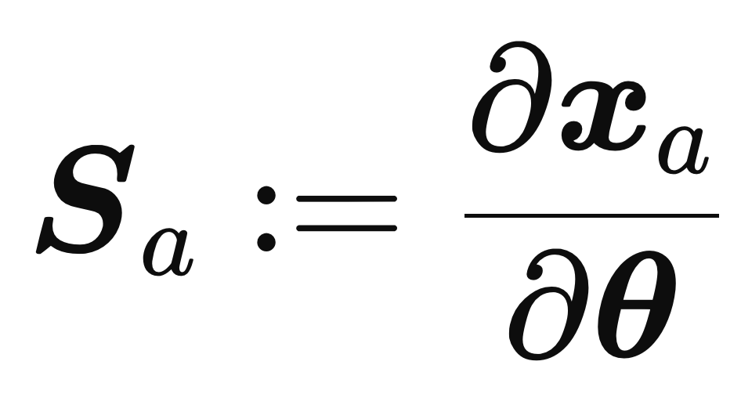
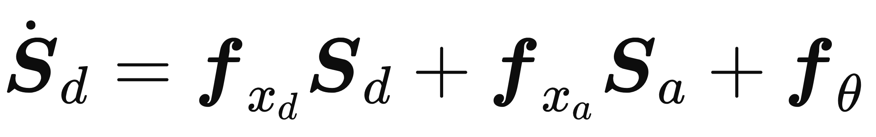
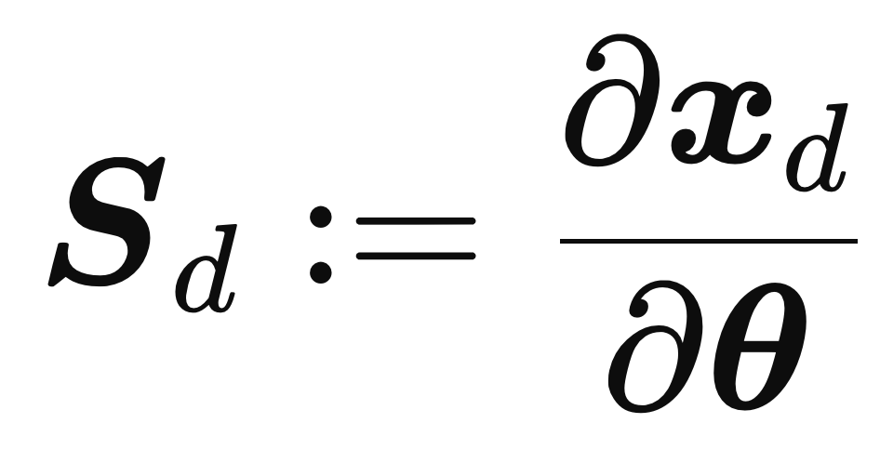
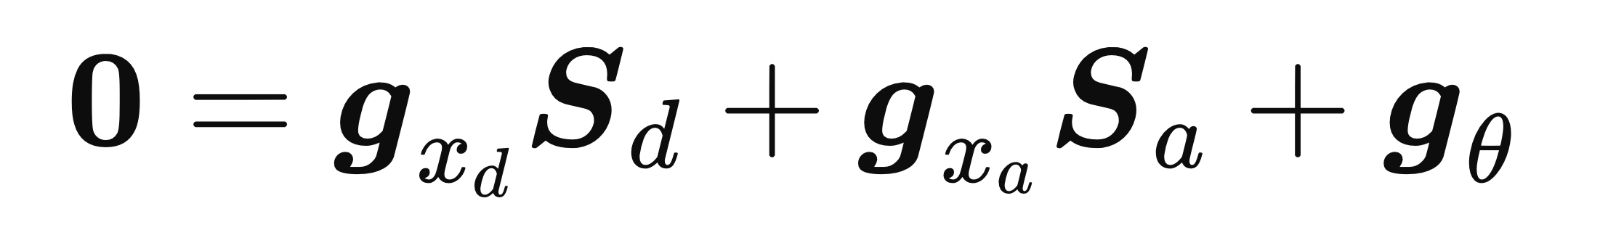
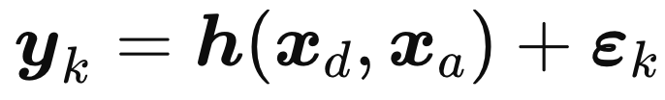
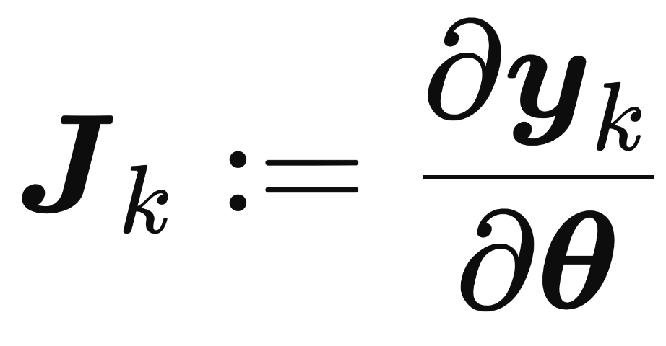
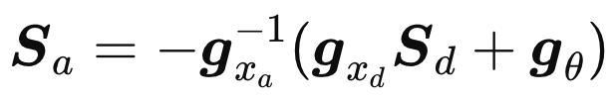

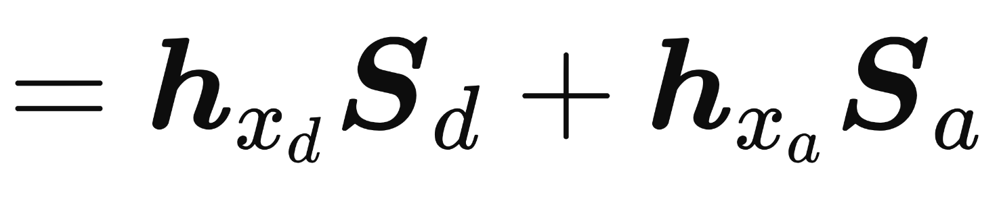
Physics DAE to Sensitivity ODE
DAE model
Sensitivity Matrices
Variational System
Measurement Model
Measurement
Sensitivity
Sensitivity ODE
Schur-complement elimination
Bus voltage phasors
Frequency deviations

Slide 9



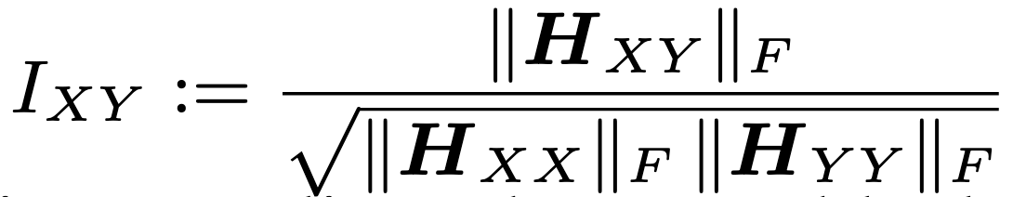

Co-Identifiability
Log-Normal Reparameterization
Enforce positivity
Models uncertainty as deviations from nominal values
Measurement
Sensitivity
Gauss-Newton curvature matrix
Co-identifiability index
How strongly PMU residuals change when parameters are perturbed
How strongly two parameter groups are co-identified from same data
Notes:
(H) tells us how strongly the data push back when we perturb the parameters. If changing a parameter produces a large change in the residuals, then the corresponding curvature is large, and that parameter is locally easier to identify.
Finally, we use this matrix to define a co-identifiability index between parameter groups. The idea is to look at the off-diagonal block of (H) that couples two groups, and normalize it by the strength of the two diagonal blocks.

Slide 10
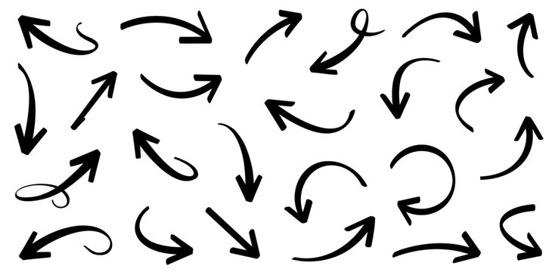
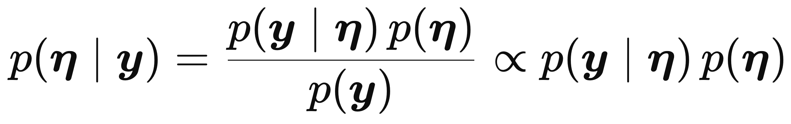
Bayesian Inference
Posterior = Likelihood x Prior ÷ Evidence
posterior
likelihood
prior
parameters
measurements
marginal likelihood (normalization)

Slide 11
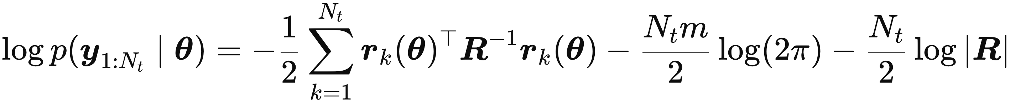
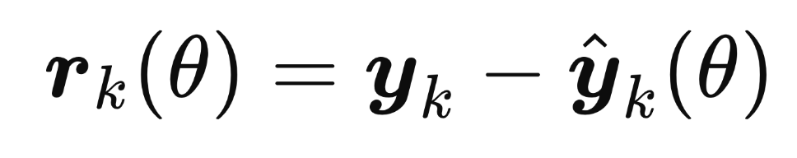
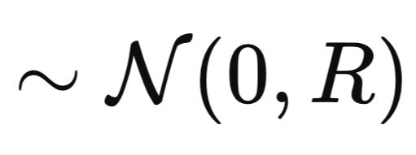

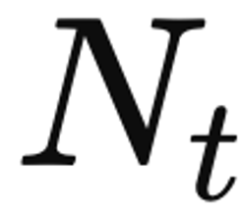
Likelihood
Probability of observing data under hypothetical parameter values
Take the log of the multivariate Gaussian density of independent samples over time
Penalizes residuals, weighted by uncertainty
Residuals
Measurement noise and model discrepancy covariance
No. of samples

Slide 12
Likelihood: Time Segmentation
Electromechanical transients exhibit useful time-scale separation:
  Initial freq. swing: inertia
  Oscillation decay: damping
  Settling response: admittance
Introduce channel specific weights to emphasize informative channels

Slide 13
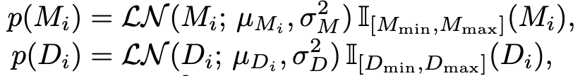
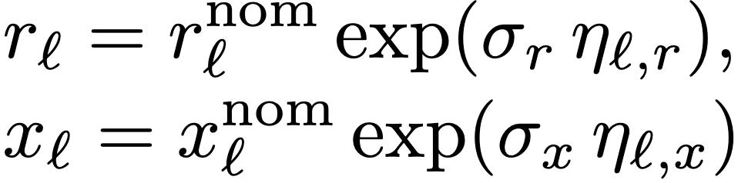
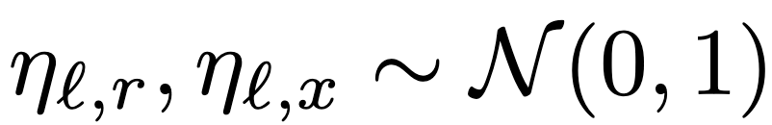
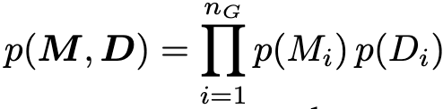
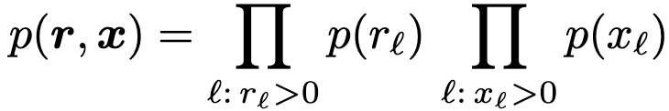
Priors
Generator Parameters
Network Parameters
M and D are positive, subject to multiplicative uncertainty (aging, rewinding), we use log-normal priors
Series r and x are positive, subject to multiplicative uncertainty (aging, temperature), we use log-normal priors
centered at nominal values (not true values)
Assumed independent across generators before PMU data update them
We sample (r, x) then assemble Y_{bus}

Slide 14
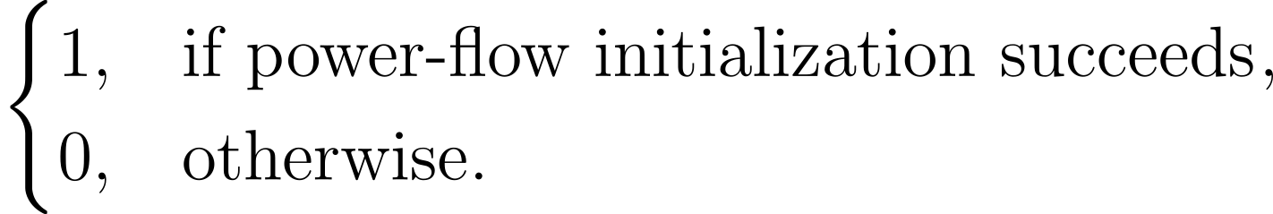
Priors
The full prior combines generator priors, network priors, and a final power flow feasibility check

Slide 15
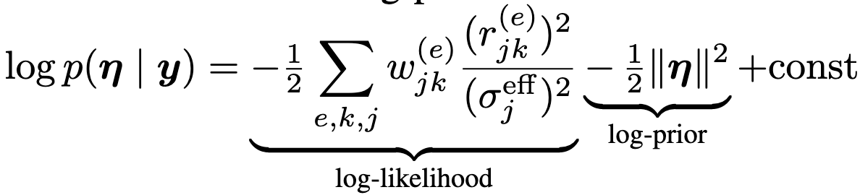
Posteriors
Target posterior: data fit, physics feasibility, and prior information
No normalization needed: MCMC compares ratios
Log posterior looks like this
Data moves posterior towards true when DAE response improves

Slide 16
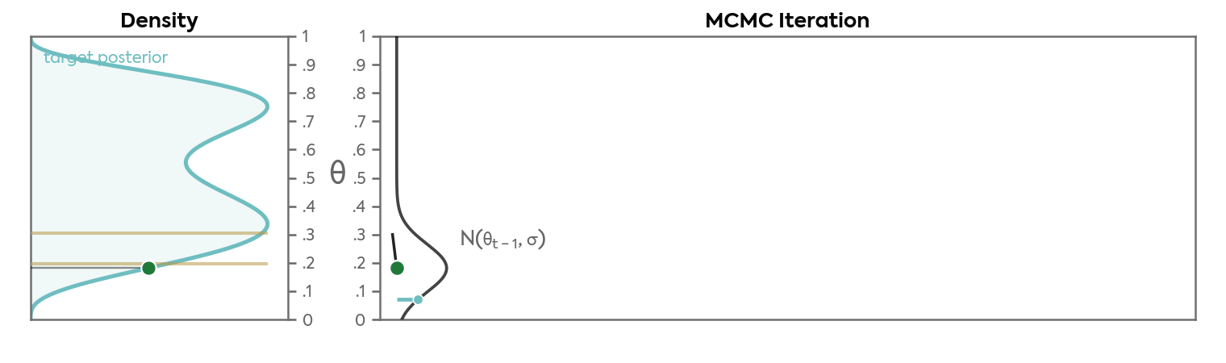
MCMC
MCMC: Sampling method that explores posterior by repeatedly proposing parameter values, keeping the ones that explain the data well, and using the accepted samples to estimate uncertainty.

Slide 17
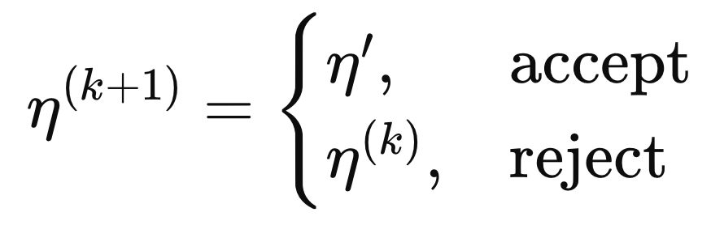

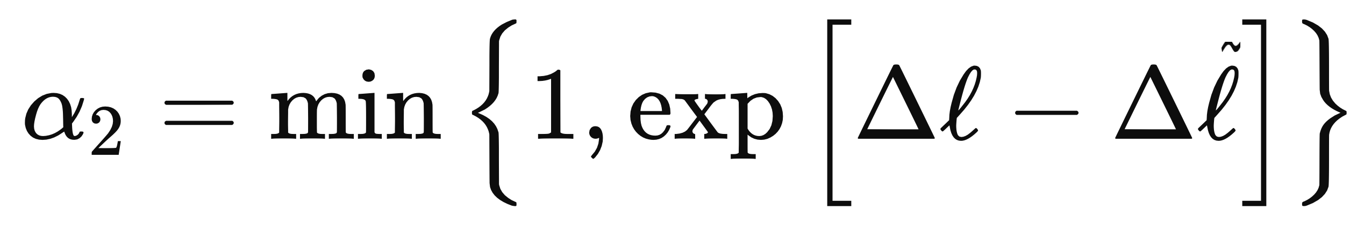
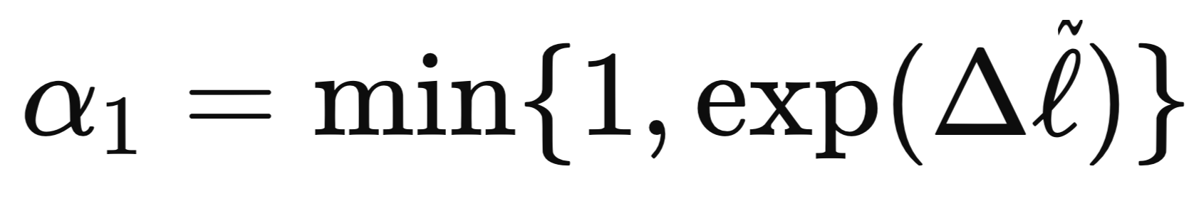


DAE MCMC
Target posterior
Exact DAE-aware
Initialize
Current MCMC state
Full DAE Solve
Accept with probability
Nonlinear LS
Metropolis correction
Perturb one block
Coarse DAE Filter
Accept with probability
Filter bad proposals
check box constraints
Obtain
PF Filter ( )
Infeasible → reject
Physical parameters

Slide 18
Practical DAE MCMC
Every posterior evaluation costs a power flow solve + a full DAE simulation
Sampler must make each solve count:
Smart Start
Blocked Proposals
Delayed Acceptance
Stagewise Initialization
Gibbs + Adaptive Covariance
Multifidelity Filter
Stage A: fit (M, D) to frequency channels
Stage B: fit (r, x) to all channels
Joint step refines both
Cycle through (M, D), r, then x
Gaussian steps in standardized log-space
Stage 0: PF infeasible? reject
Stage 1: coarse DAE screens cheaply
Stage 2: full DAE for survivors
Outcome: same posterior as plain Metropolis-Hastings with fewer exact DAE solves.

Slide 19
Case Studies
Simulate the DAE at perturbed true parameters, then add measurement noise
 | IEEE 9-bus | IEEE 39-bus
Role | Main validation | Larger proof-of-concept
System | 3 gen., 9 buses, 9 branches | 10 gen., 39 buses, 46 branches
Unknowns | n_{θ} = 21 | n_{θ} = 108
Measurements | 17 PMU channels | 68 PMU channels

Slide 20
Co-Identifiability
Initial observation: weak co-identifiability. Oops, paper dead?
Means sensitivity coupling is
small at the chosen point (local)
Does not mean decoupled
estimation is unbiased
Fixing an incorrect parameter
group can still force the estimated
group to compensate through the
nonlinear DAE model

Slide 21
Joint Estimation
Estimates move from nominal to real values
Uncertainty shrinks significantly from the prior
Generator and network parameters are calibrated together

Slide 22
Joint vs. Decoupled
Joint closer to true values across all parameters
Decoupled shifts posterior because fixed parameter group is wrong
Bias seems largest for damping
Joint estimation gives tighter better-centered posteriors

Slide 23
Computational Cost & Scaling
IEEE 9-bus: delayed acceptance reduces expensive full DAE solves
Run | Iterations | Time | Exact solves reduction | 95% CI coverage
Joint, reduced-budget | 500 | 7.2 min | 50.6% | 12/21
Joint, full-budget | 7000 | 30.4 min | 70.1% | 21/21
IEEE 39-bus
Proof-of-concept, under-calibrated
Metric | 39-bus results
Unknown parameters | 108
Run budget | 1000
Exact DAE solves | 765 (23.5% fewer)
Mean rel. error: M / D | 3.32% / 3.98%
Mean rel. error: r / x | 4.82% 2.45%
95% CI coverage | 14/108 (under calibrated)
Wall-clock time | 65.8 min
Reviewer 2 insisted

Slide 24
Limitations
Scalability is hard but possible, suited for offline calibration
Needs informative data and recorded disturbance profiles
The inverse crime: data generated from the same model
Future work: real data, joint real-time calibration with UQ?

Slide 25
Conclusion
Joint generator-network estimation matters, decoupled estimation can bias both sides
Framework provides uncertainty, credible intervals, and jointly consistent parameter sets
DAE-aware inference keeps parameter estimates tied to physical power flow feasibility

Slide 26
Thank You
Questions?

Slide 27

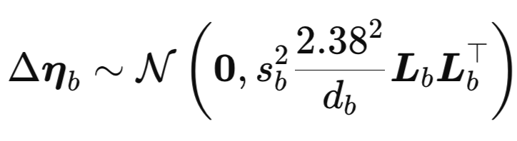
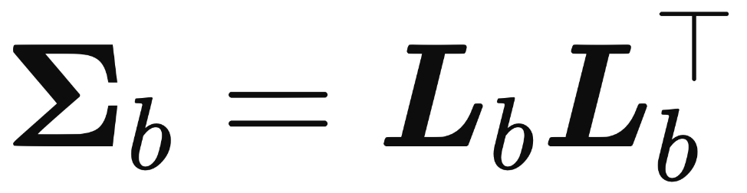

MCMC: Blocked Gibbs Proposals
Split parameters into three blocks
Start from the full vector and draw a random Gaussian step for that block:
Proposal step
Then propose while keeping other blocks fixed
b: selected block
d_{b}: number of parameters in the block
s_{b}: adaptive scalar step-size for block b
L_{b}: Cholesky factor of block covariance
obtained from matrix H

Slide 28

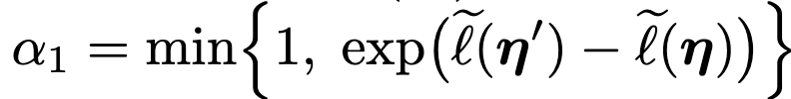
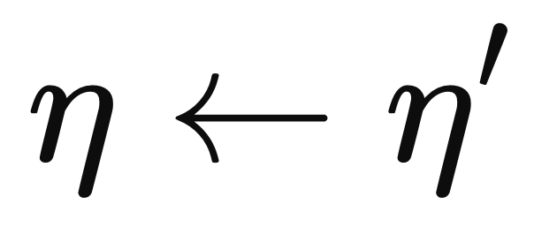
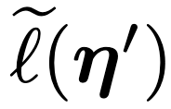
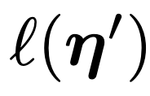
MCMC: Delayed Acceptance
Check whether proposal is acceptable:
Check box constraints , if not inside → reject
Map to physical parameters:
Solve PF with proposed parameter: if infeasible → reject
Run a coarse DAE simulation (relaxed tolerances), accept with probability
(filter bad proposals to avoid full DAE solves)
Run full DAE simulation, accept with probability
If accepted:
: Cheap log-posterior (coarse)
: Exact log-posterior (full)

Slide 29
MCMC: Stagewise initialization
For initialization, instead of starting MCMC from nominal values:
Use stagewise nonlinear least squares to start MCMC near a high-posterior region
Stage A estimates (𝑀, 𝐷) from frequency residuals with network fixed
Stage B estimates (𝑟, 𝑥) from all-channel residuals with dynamics fixed
Joint step: refine parameters, provide local curvature for proposal covariances

